Slide 1
Hello Watch! Build your First Apple Watch App
Kristina Thai
iOS Software Engineer
@kristinathai
Mayuko Inoue
iOS Software Engineer
@hellomayuko
Download project files:
bit.ly/ghcwatch
Notes:
download the project file
have xcode
LAUNCH XCODE NAO
if wifi isn't working, use USB sticks
otherwise pair up with a neighbor

Slide 2

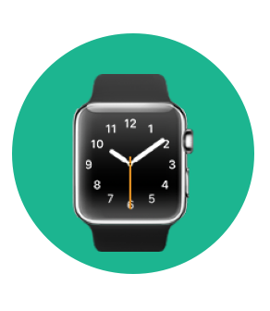


Hi, I’m Kristina!

Slide 3



Hi! I’m Mayuko

Slide 4
Workshop Agenda
Intro to Apple Watch Development
Hello Watch! App
Counter App with iPhone Companion App
Resources and Q&A
Notes:
slightly more complicated Counter App with iPhone companion app

Slide 5
Apple Watch

Slide 6
Apple Watch
Notes:
Introduced in 2014 – Most personal wearable device apple has ever created
Use cases for this are much different than any mobile device created before
Applications of health & fitness, tracking, etc. Only the beginning

Slide 7
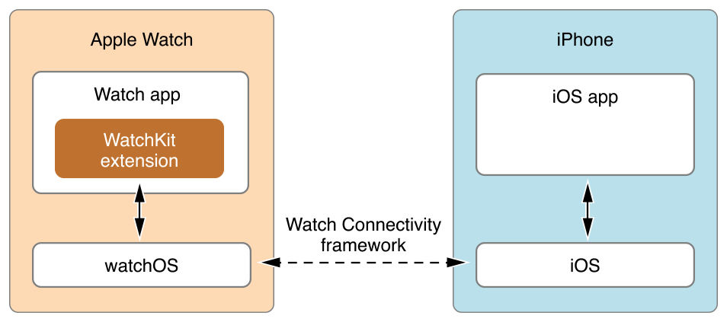
Apple Watch Architecture

Slide 8
Hello Watch! App

Slide 9
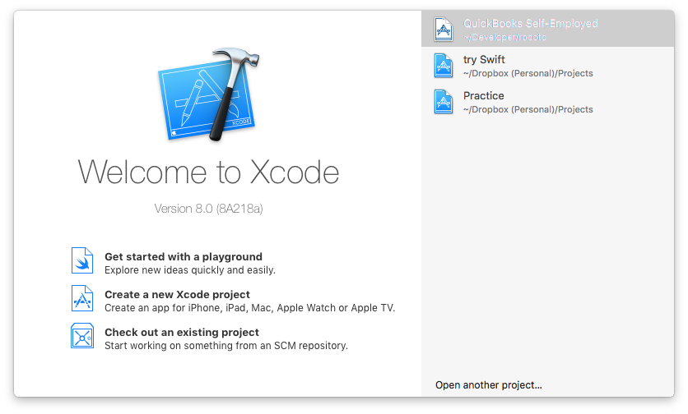
Hello Watch Application

Slide 10
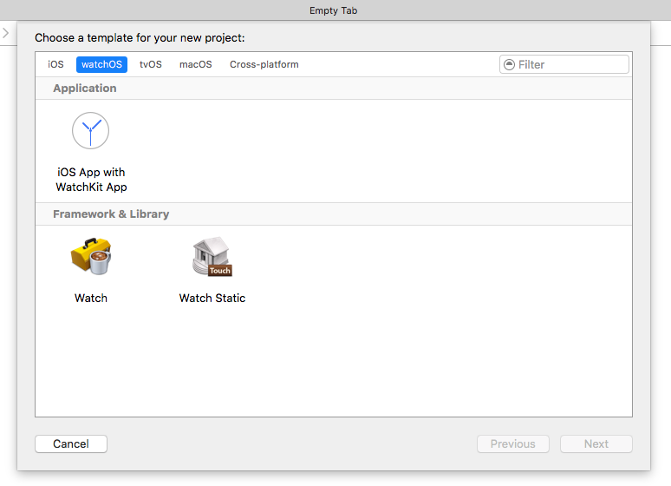
Choose App Type

Slide 11
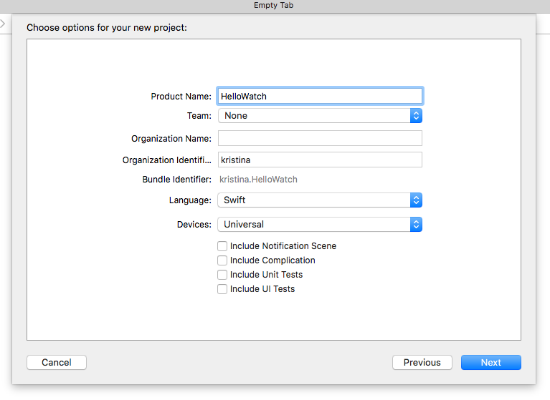
Name Your Project
Notes:
Press Next, and save where ever you’d like to save the project. Once you choose that location, press Create

Slide 12
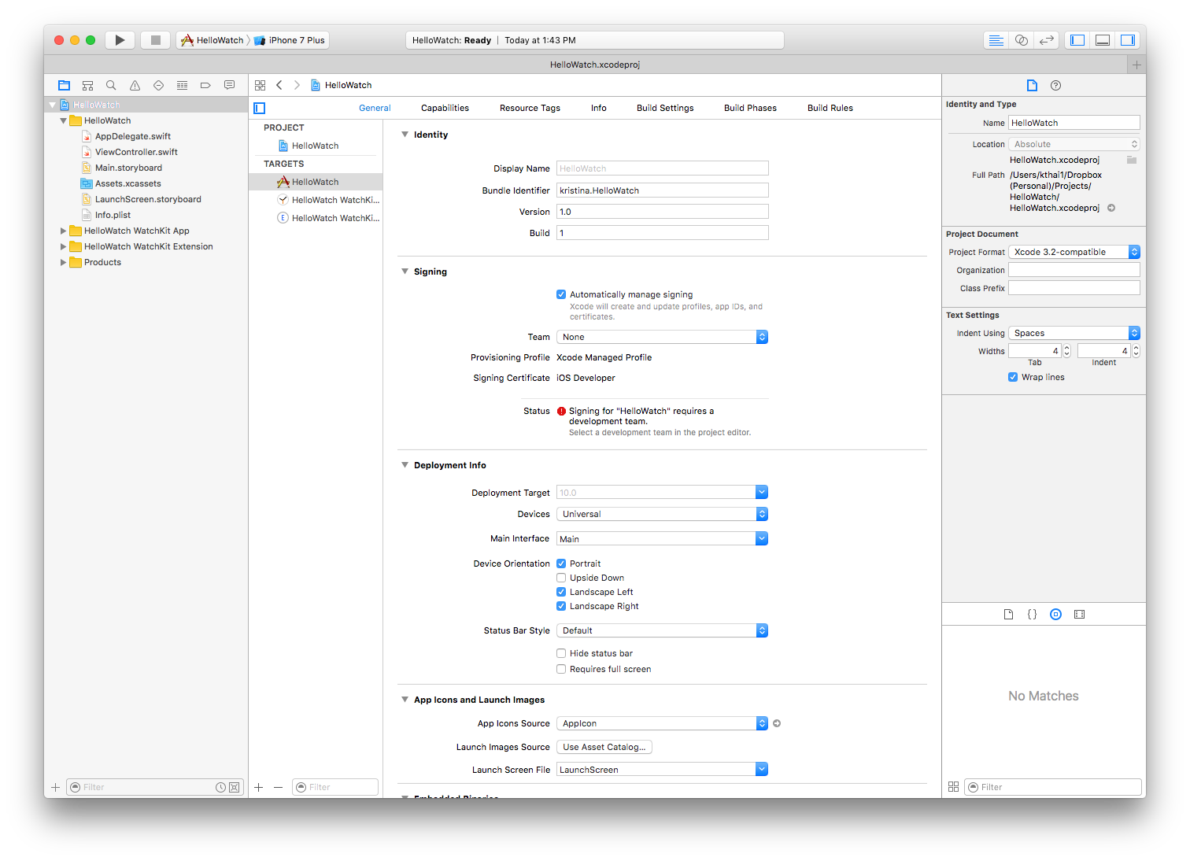
You’re In!

Slide 13
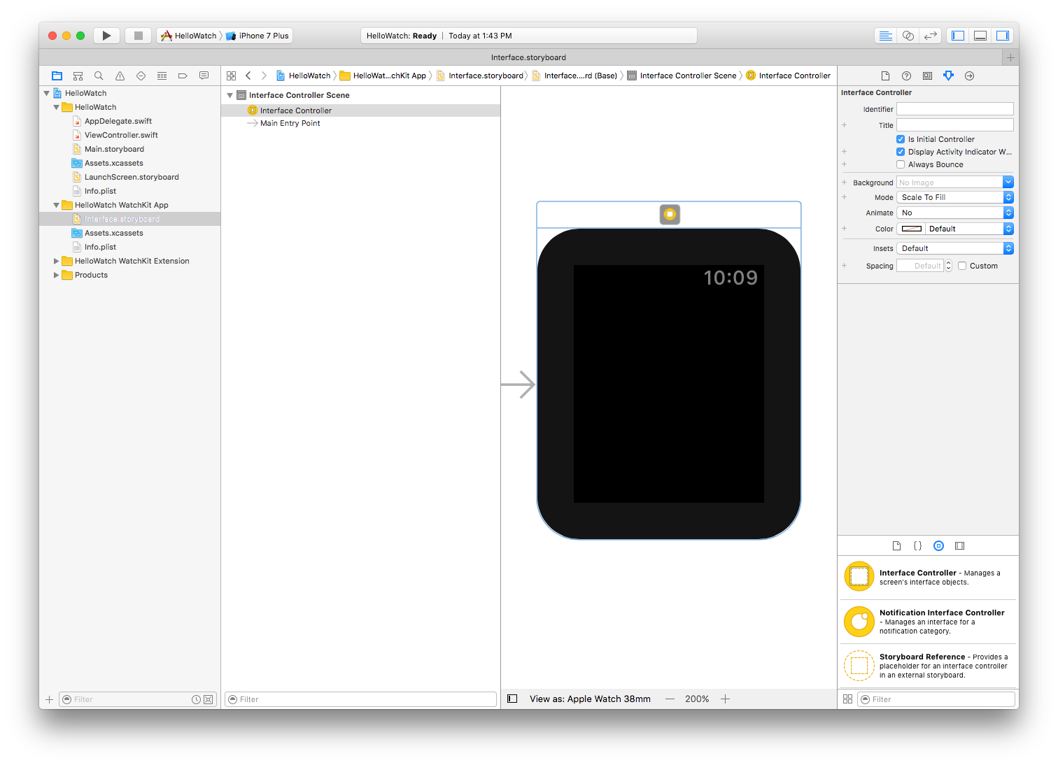
Build the Interface
Notes:
On left side bar, Click on Hello Watch WatchKit App
Blank watch face

Slide 14
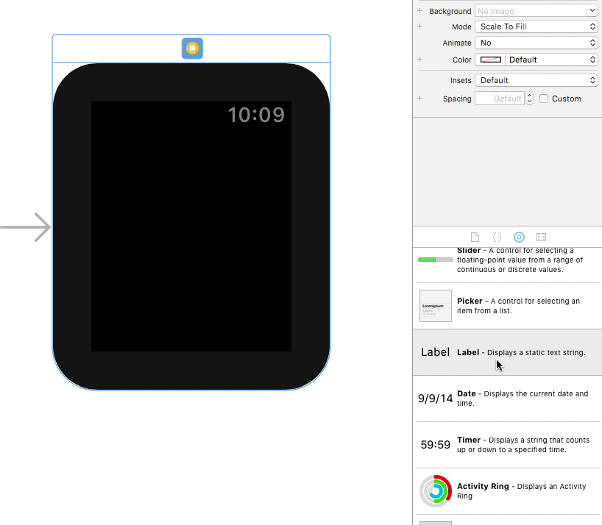

Drag the Label
Notes:
On the bottom half of the right sidebar, click on icon in the shape of a Circle with a square inside it (3rd from the left)

Slide 15
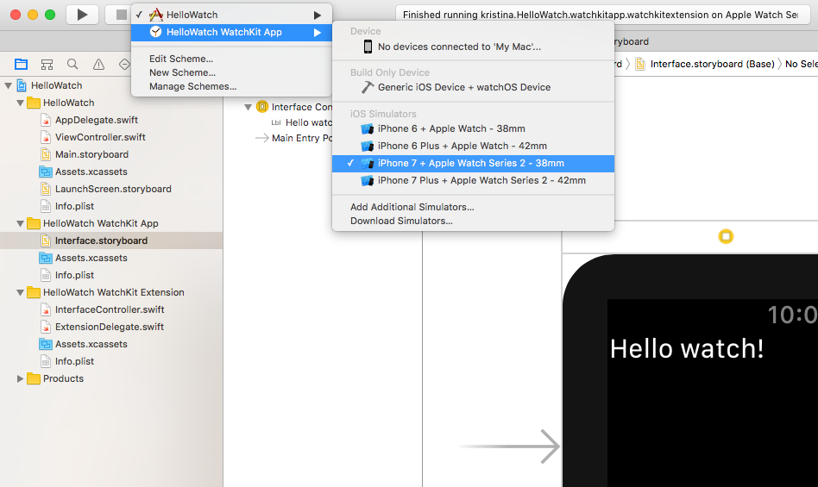
Pick a Scheme…and Run!
Notes:
Once you click run, it’ll take a while before you see the app come up. Ignore phone app (nothing will happen there)

Slide 16
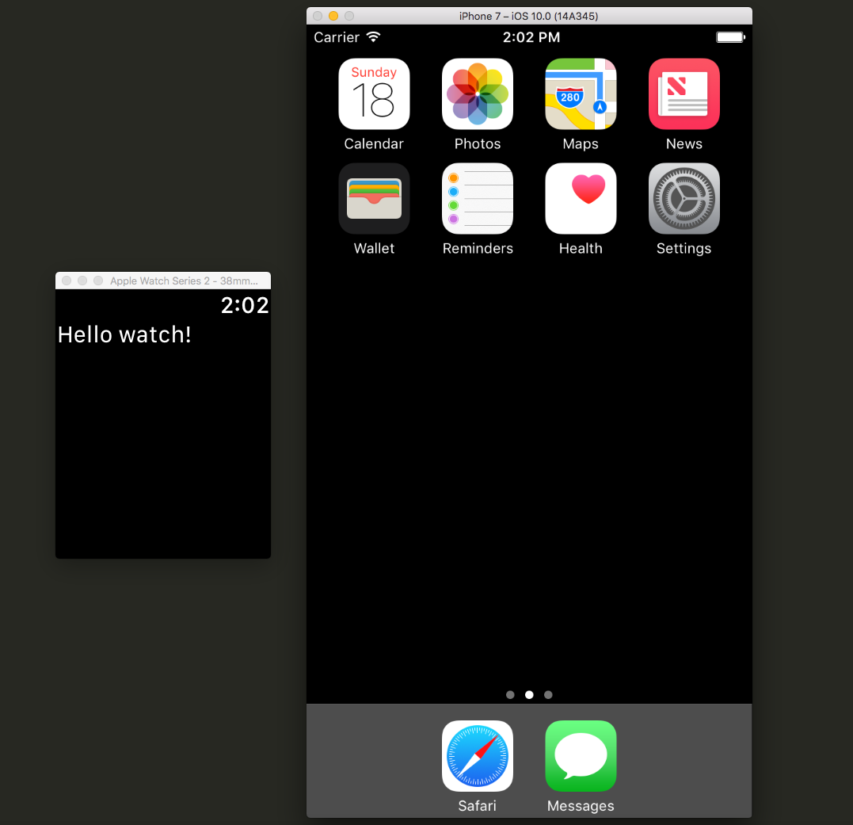
Launch the App!
Notes:
We'll pause here and walk around to see that everyone is up to speed

Slide 17
Watch Counter App (with iPhone Companion App)

Slide 18
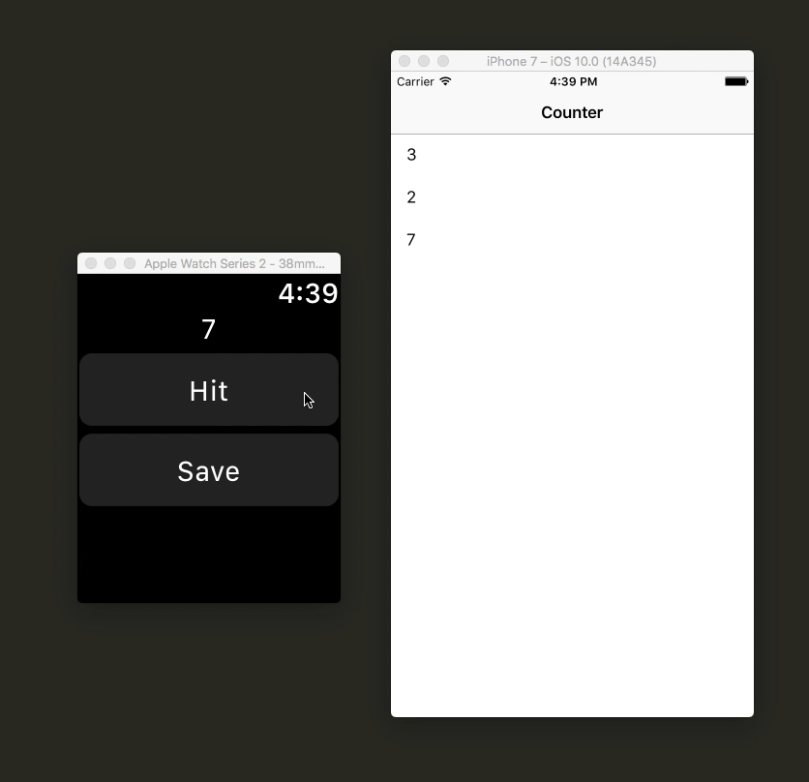
Final Product
Increment
Notes:
iPhone app already done, we’re just going to work on the watch part

Slide 19
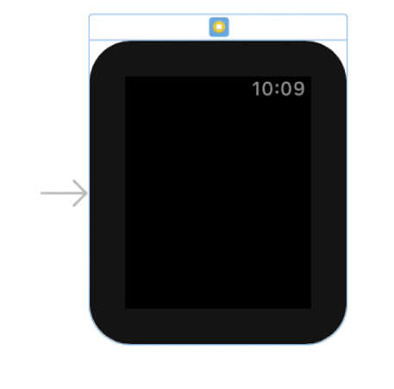
Counter Application
Open the Xcode project that we gave you (Counter.xcodeproj)
bit.ly/ghcwatch
On left sidebar, navigate to Counter WatchKit App > Interface.storyboard

Slide 20

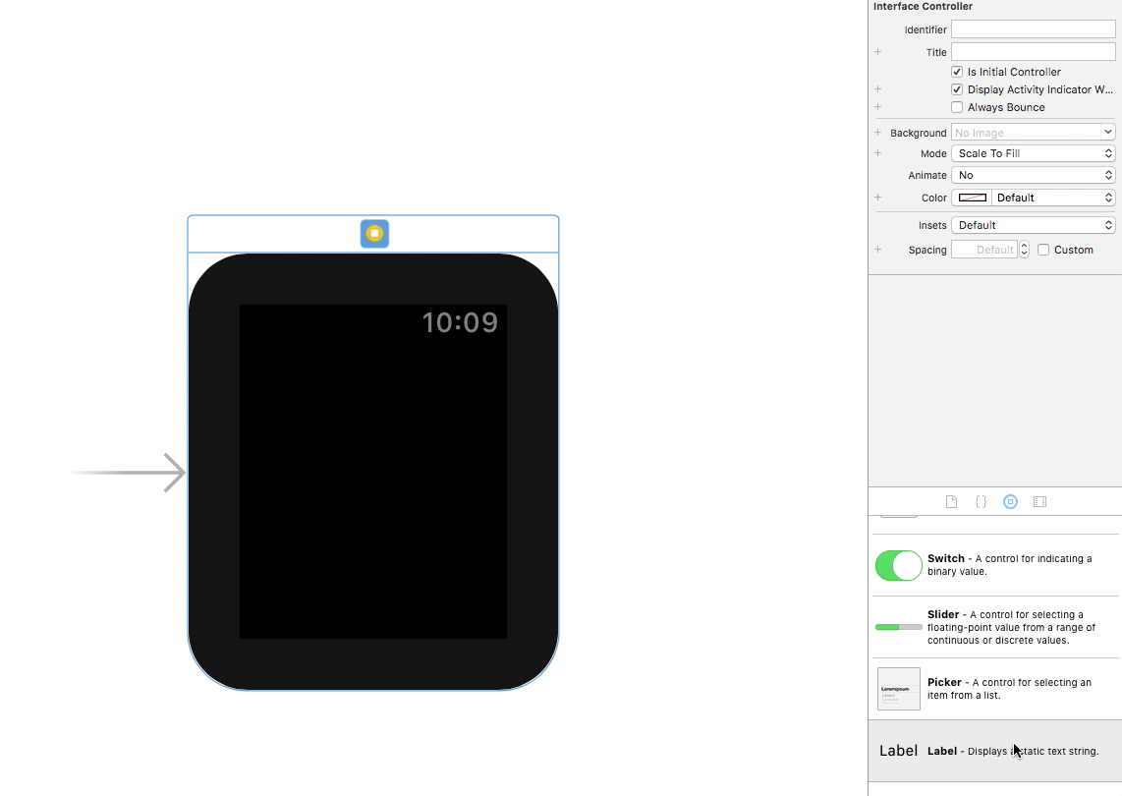
Setup the Counter Label
Notes:
Look for the bookmark arrow – second from the right

Slide 21
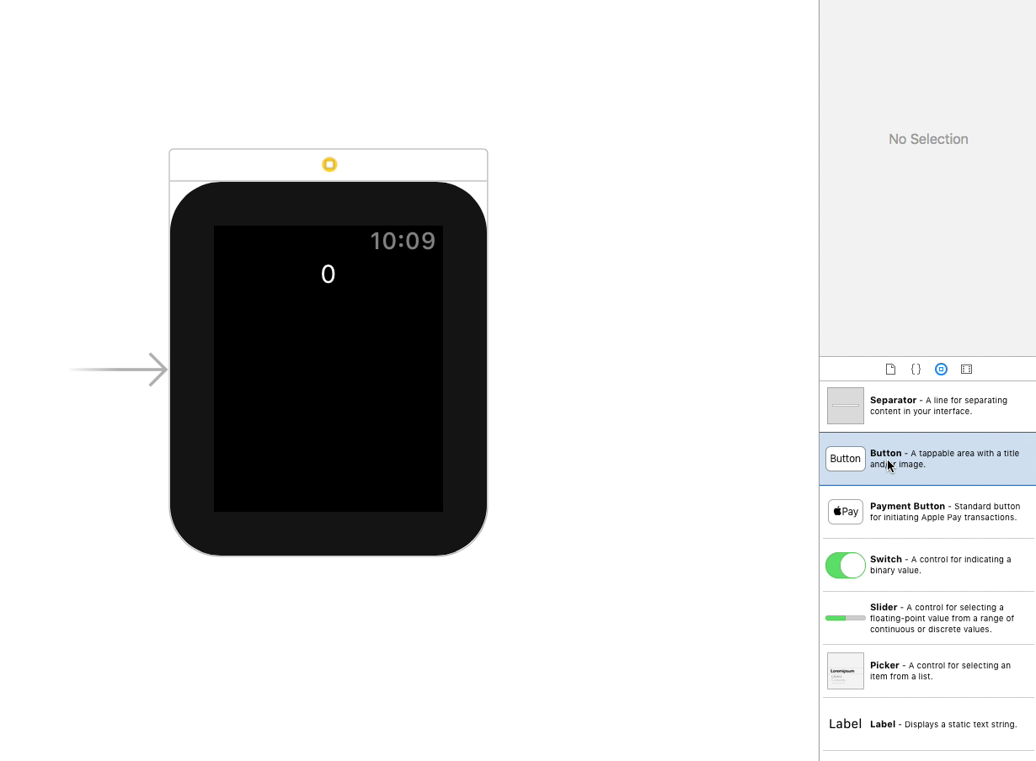
Add the buttons

Slide 22
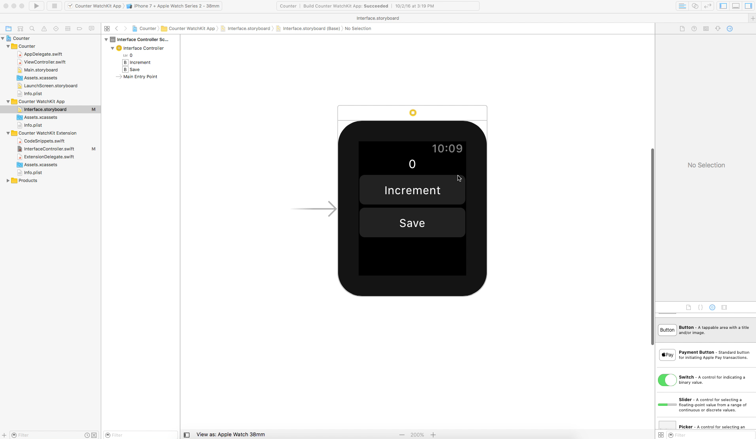
Go into split view

Slide 23
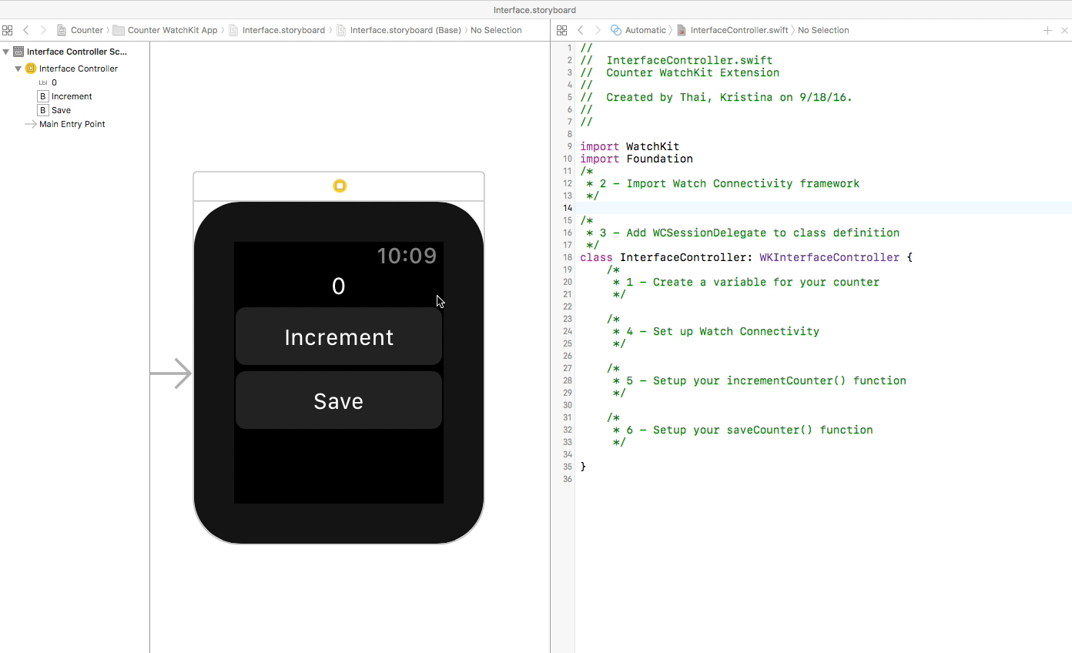
Connect the counter label outlet

Slide 24
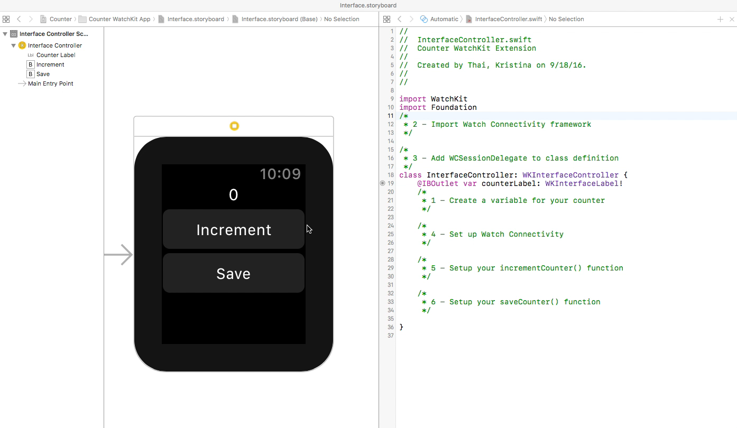
Connect the button actions

Slide 25
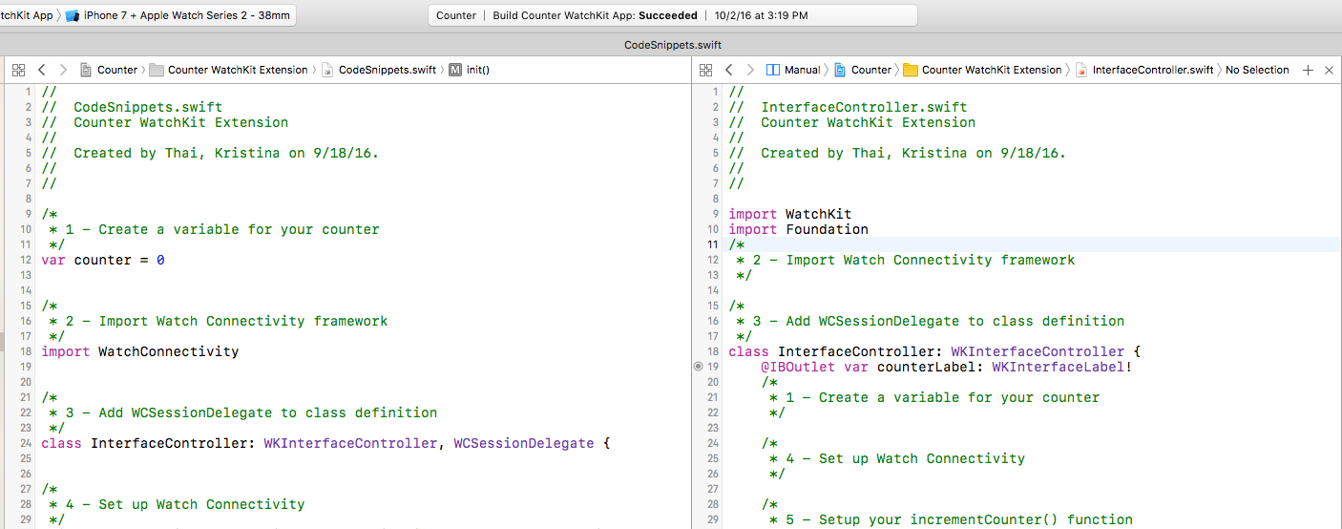
Time to code!
On the left sidebar, go to the Counter WatchKit Extension folder and click on
“CodeSnippets.swift”
Hold down the Option key and click on “InterfaceController.swift”

Slide 26
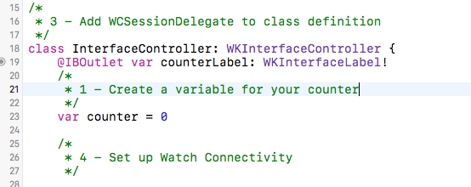
1 – Create a variable for your counter

Slide 27
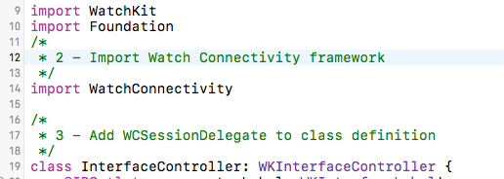
2 – Import Watch Connectivity framework

Slide 28
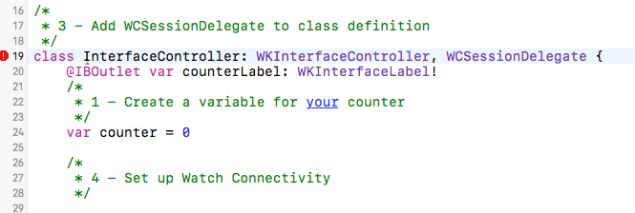
3 – Add WCSessionDelegate to class definition
Notes:
Delegate allows us to say we’re supporting Watch Connectivity in this file
Don’t worry if you see an error pop up, we’ll fix this in the next step

Slide 29
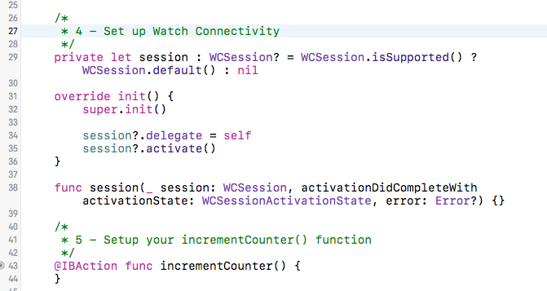
4 – Setup Watch Connectivity
Notes:
opens up the connection between the watch and the phone
Notice that the error goes away now that we’ve set up the necessary function for the WCSession delegate

Slide 30
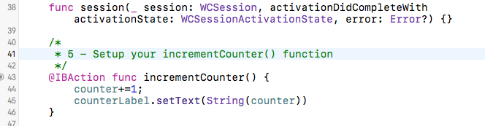
5 – Setup your incrementCounter() function
Notes:
copy and paste the code INTO the saveCounter function

Slide 31
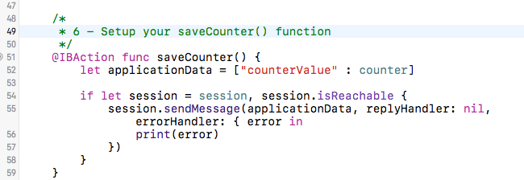
6 – Setup your saveCounter() function
Notes:
copy and paste the code INTO the incrementCounter function

Slide 32
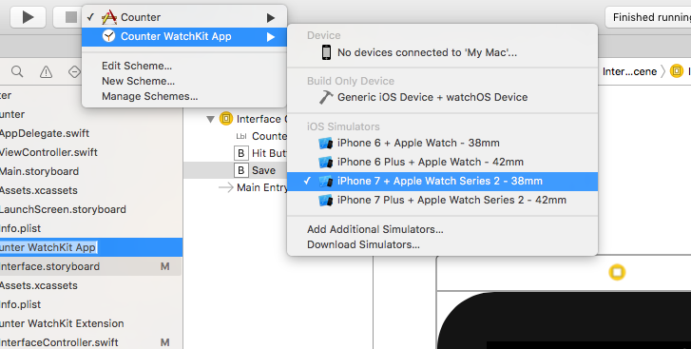
Choose Your Scheme…and Run!
Notes:
Remember, iPhone app is already done so it should just work for you now if you’ve done the watch correctly

Slide 33
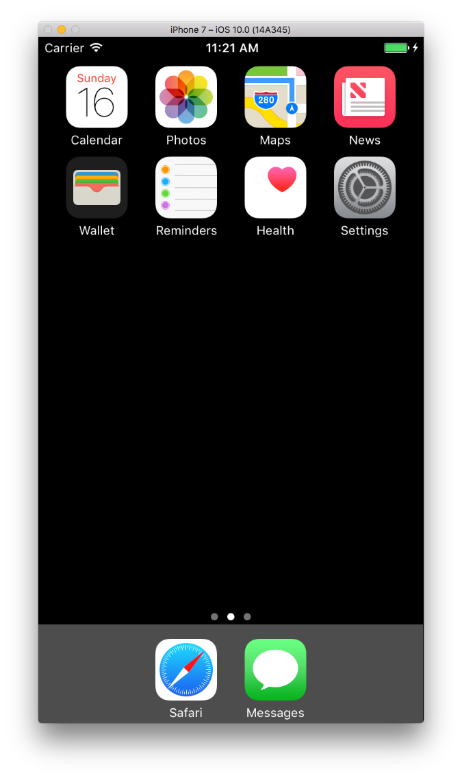
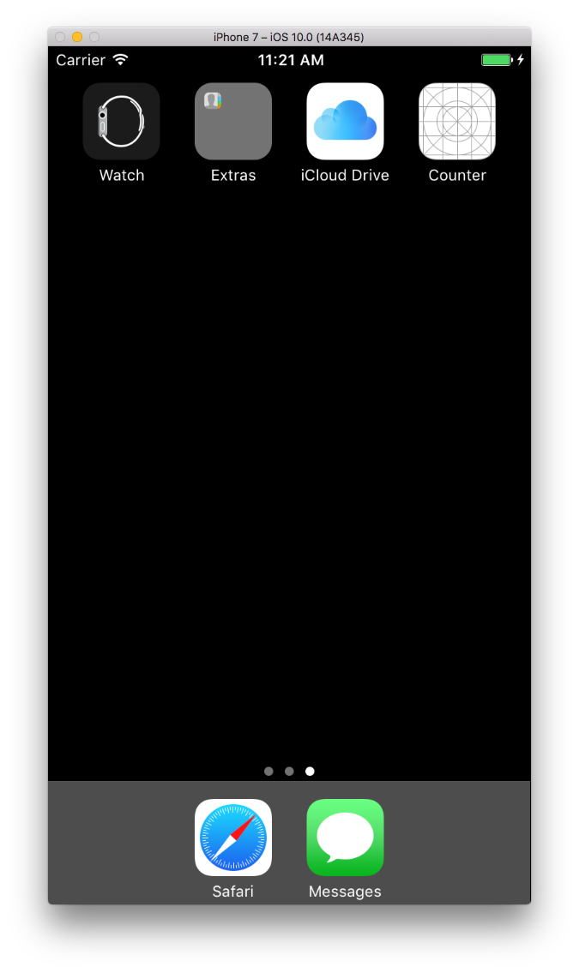
Open the Counter app on the iPhone
Swipe left to get to the 2nd page
Click on the
Counter app
Notes:
Your watch app will launch by itself. You need to manually launch the phone app

Slide 34
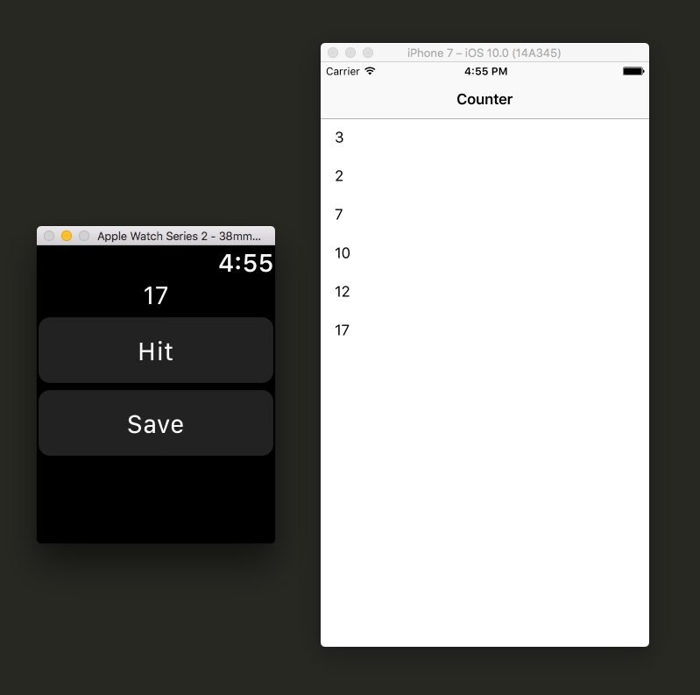
Counter Application
Increment
Notes:
It will take a long time for your watch & iPhone apps to load
Watch Connectivity may not work very fast either – make sure you don’t have any error messages in your console

Slide 35
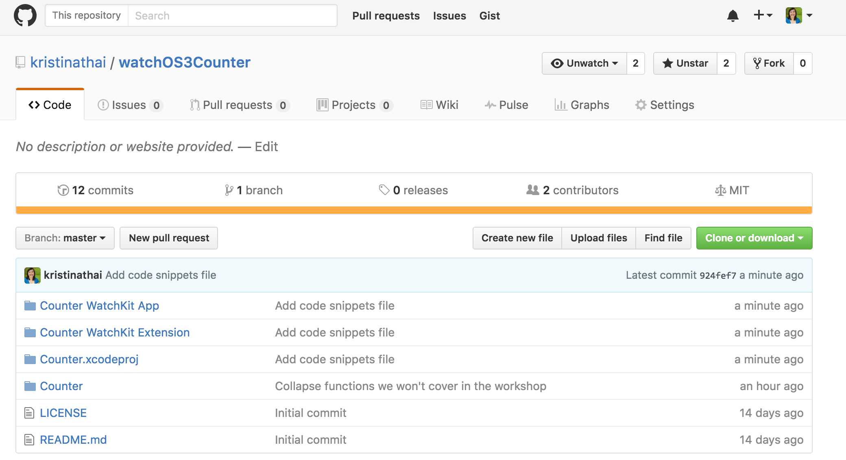
Final Project Code
https://github.com/kristinathai/watchOS3Counter

Slide 36
Resources and Q&A

Slide 37
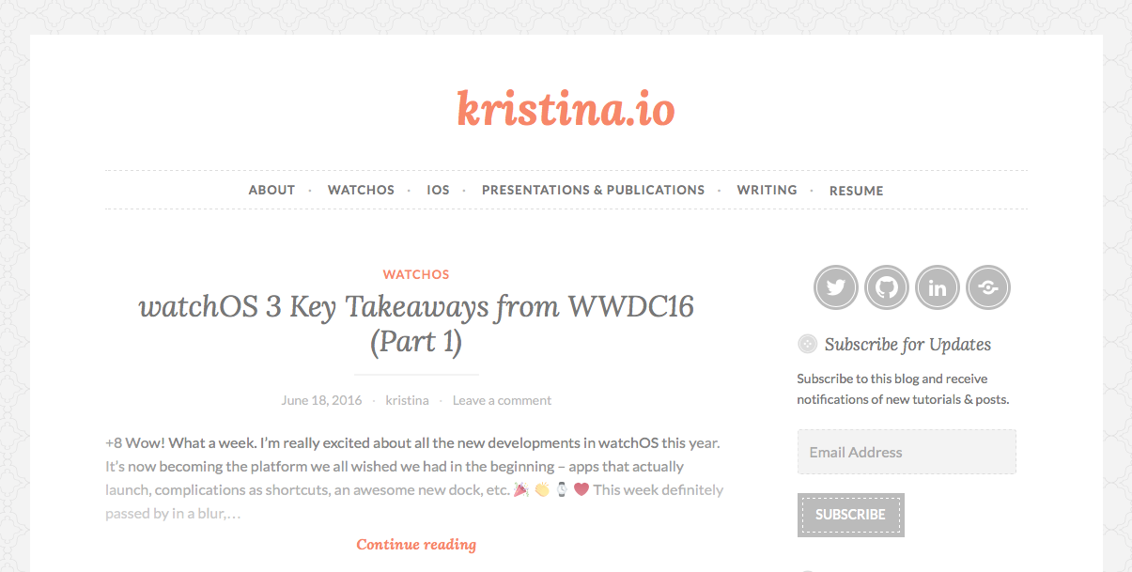
Kristina’s iOS & watchOS Blog

Slide 38
Resources
App Programming Guide for Apple Watch
Apple Watch Human Interface Guidelines
Ray Wenderlich
Natasha the Robot

Slide 39
Thanks!
Kristina Thai
Kristina_Thai@intuit.com
@kristinathai
Mayuko Inoue
mayuko@patreon.com
@hellomayuko

Slide 40
@kristinathai @hellomayuko
Rate and review the session on our mobile app

